Slide 1

CREDIT CARD FRAUD DETECTION USING DEEP LEARNING
LEVERAGING ADVANCED TECHNOLOGIES FOR ENHANCED SECURITY
PRESENTED BY:DEEPALAKSHMI.S
III YEAR,KVCET,CSE
NMID:au421221104009
Gmailid:buijideepa@gmail.com

Slide 2
INTRODUCTION
Credit card fraud is a type of financial fraud that involves unauthorized or fraudulent use of someone else's credit card or card information to make purchases or withdraw funds. It is a serious and prevalent form of cybercrime that affects individuals, businesses, and financial institutions worldwide.
Credit card fraud refers to the illegal and unauthorized use of a credit card or its information to make purchases, obtain cash advances, or perform other transactions without the cardholder's consent

Slide 3
the main objectives of a credit card fraud detection project using deep learning techniques
Improving Accuracy
Reducing False Positives
Enhancing Security
Real-time Detection
Scalability
Continuous Monitoring and Improvement
Interpretability
Compliance

Slide 4
Problem Statement
In the realm of financial transactions, credit card fraud has become a pressing issue, costing billions of dollars annually to both financial institutions and consumers. Traditional fraud detection methods, such as rule-based systems and statistical models, are struggling to keep pace with the evolving sophistication of fraudsters. As a result, there is a critical need to develop a more robust and efficient fraud detection system leveraging deep learning techniques.

Slide 5
Why we use deep learning for credit card fraud detection ?
Increasing instances of credit card fraud pose significant challenges to financial institutions and consumers alike. Current fraud detection methods often fall short in accurately identifying fraudulent transactions, leading to substantial financial losses and customer inconvenience. The need of the hour is to develop an advanced credit card fraud detection system using deep learning algorithms that can effectively distinguish between legitimate and fraudulent transactions in real time, thereby reducing false positives, minimizing financial losses, and enhancing overall security in the financial sector

Slide 6
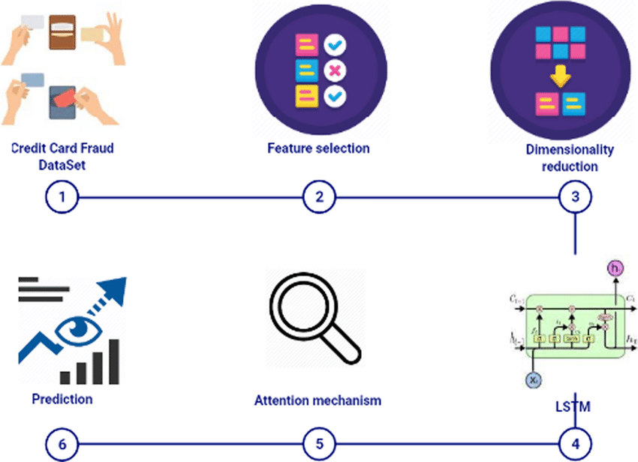
Proposed system

Slide 7
SYSTEM REQUIREMENTS
Data Collection and Preprocessing, Feature Selection, Model Evaluation and Testing , Deployment and Integration, Deep Learning Model Selection, Model Training
REQUIREMENTS
1.Hardware Requirements:
      Sufficient computational resources (CPU/GPU) for training deep learning models efficiently.
      Storage space for storing and processing large datasets.
    2.Software Requirements:
      Deep learning frameworks (TensorFlow, PyTorch, or Keras )for model development.
      Data processing libraries ( Pandas, NumPy) for data manipulation and preprocessing.
      Visualization tools (Matplotlib, Seaborn) for data analysis and model performance evaluation.

Slide 8
PROBLEM FORMULATION
Formulating the problem for credit card fraud detection involves defining the task, identifying key objectives, specifying input data, and outlining desired outcomes. Here's a structured approach to formulating the problem for credit card detection using deep learning
Problem Definition:
  Define the task as binary classification: distinguishing between legitimate and fraudulent credit card transactions.
Objectives:
  Minimize false positives (legitimate transactions flagged as fraudulent) to prevent inconveniencing customers.
  Minimize false negatives (fraudulent transactions not detected) to reduce financial losses for the card issuer.
Input Data:
  Transaction Data: Include features such as transaction amount, time, location, merchant category, cardholder information, etc.
  Labeling: Each transaction is labeled as legitimate (0) or fraudulent (1) based on historical records or fraud detection systems.

Slide 9
Historical Data: Use historical transaction data to train the model and detect patterns indicative of fraud
  Accuracy: Overall correctness of the model's predictions.
  Precision: Proportion of correctly predicted fraudulent transactions among all transactions predicted as fraudulent.
  Recall (Sensitivity): Proportion of correctly predicted fraudulent transactions among all actual fraudulent transactions.
  F1-Score: Harmonic mean of precision and recall, providing a balanced measure of model performance.
  ROC-AUC (Receiver Operating Characteristic - Area Under Curve): Performance measure indicating the model's ability to distinguish between classes across different thresholds.
5.Model Selection and Validation:
  Choose appropriate deep learning models such as Convolutional Neural Networks (CNNs) data characteristics and task complexity.
  Split the data into training, validation, and test sets for model training, hyperparameter tuning, and performance evaluation.
  Validate the model using cross-validation techniques (e.g., k-fold cross-validation) to ensure robustness and generalization
6.Feature Engineering:
  Extract meaningful features from the input data, considering time-based patterns, transaction amounts, frequency of transactions, etc.

Slide 10
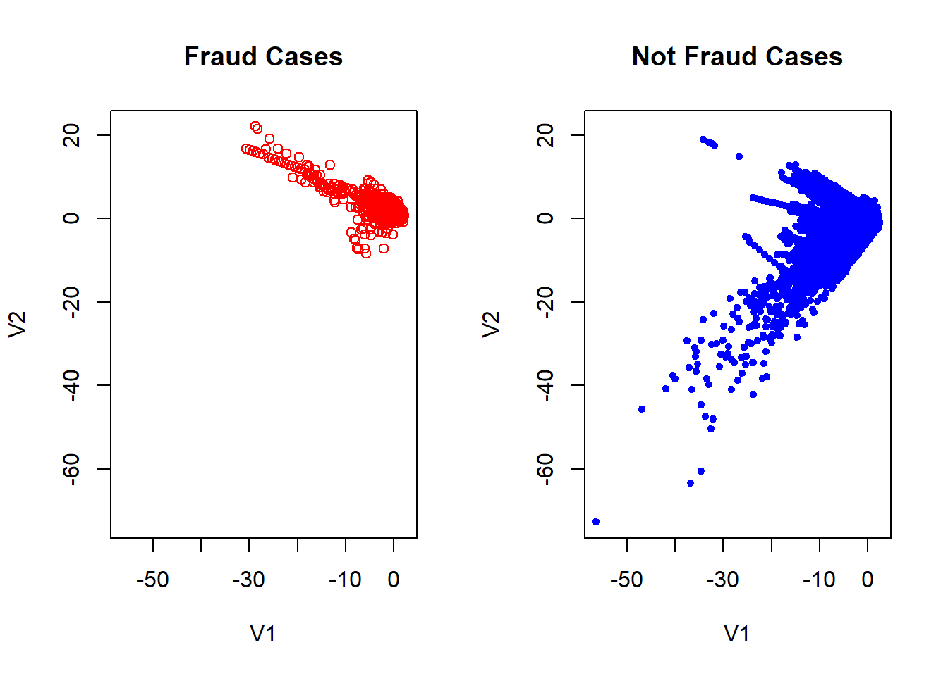
ACCURACY

Slide 11
CONCLUSION
credit card detection using deep learning represents a sophisticated and effective approach to mitigate fraud risks, protect financial assets, and ensure a secure and trustworthy payment ecosystem for businesses and consumers alike. Continuous innovation, technological advancements, and collaborative efforts are key drivers in advancing the capabilities and resilience of fraud detection systems in the ever-evolving landscape of financial cybersecurity.

Slide 12
FUTURE WORKS
Temporal and Sequential Analysis: Extend CNN architectures to incorporate temporal and sequential analysis of transaction data. This can involve integrating Recurrent Neural Networks (RNNs) or Transformer models to capture temporal dependencies and transaction sequences, leading to more accurate fraud detection.
Adversarial Robustness: Enhance CNN models' robustness against adversarial attacks by incorporating techniques such as adversarial training, robust optimization, and model distillation. Adversarial examples in credit card fraud detection scenarios pose significant threats, and mitigating these risks is crucial for real-world deployment.
Explainability and Interpretability: Develop methods to improve the explainability and interpretability of CNN-based fraud detection models. Techniques such as attention maps, feature importance analysis, and model visualization can help stakeholders understand model decisions and gain insights into fraud detection mechanisms.
Imbalanced Data Handling: Address the challenge of imbalanced data distribution in credit card fraud detection datasets. Explore techniques such as oversampling, undersampling, synthetic data generation, and cost-sensitive learning to handle class imbalance effectively and improve model generalization.

Slide 13
www.researchgate.ne
link.springer.com › 10Credit card fraud detection using a deep learning multistage ...
https://github.com/topics/credit-card-fraud-detection
https://github.com/topics/credit-card-fraud-detection
https://www.tandfonline.com/doi/full/10.1080/08839514.2022.2086354

Slide 14
THANK YOU

